Slide 1
Final Lab Exercise - Hands-on Exercise Part
Secure Communication with Stunnel
Due Saturday, May 28th, 2022 @ 11:59pm
(18% of the total course grade)
* It will be graded.
Notes:
This is Hands-on Exercise Part of Final Lab Exercise, and it will be graded.
In this Hands-on Exercise, you are going to learn how to use open source tools, Stunnel and OpenSSL, to secure the communication over a public network.
The purpose of this lab is to help you better understand the concept of secure communication using cryptography.

Slide 2
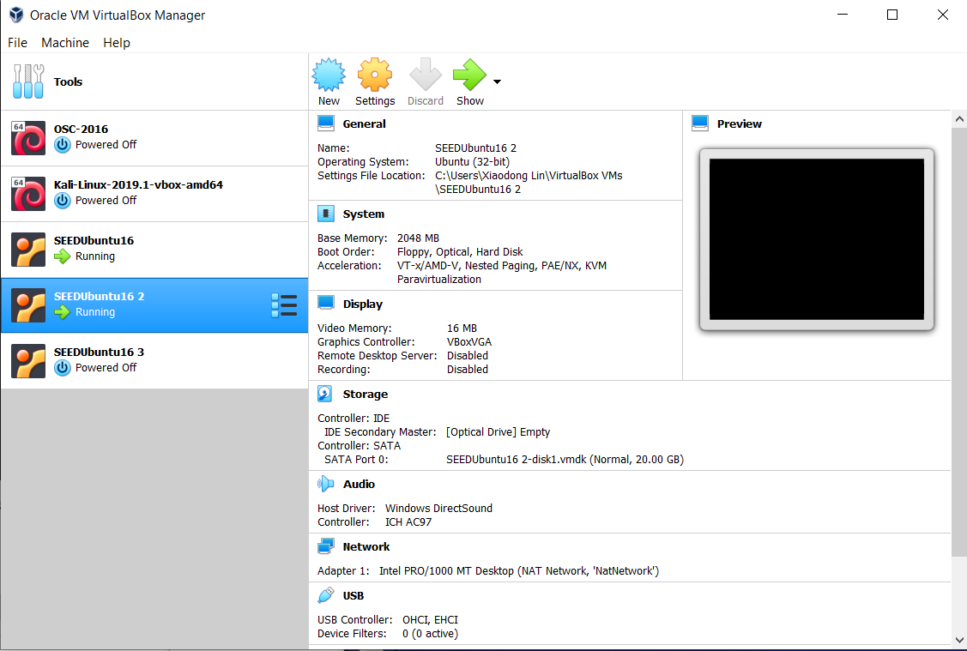

Install Stunnel
Notes:
For this lab, you will need to start two VMs. Also, you will need to install the Stunnel, a Universal SSL Wrapper onto two VMs you are using this lab. To install Stunnel on Ubuntu, type
sudo apt-get install stunnel

Slide 3

Netcat - The Swiss Army Knife of Hacking
Notes:
In our lecture, we already introduced a popular security tool called netcat, also known as The Swiss Army Knife of Hacking.

Slide 4
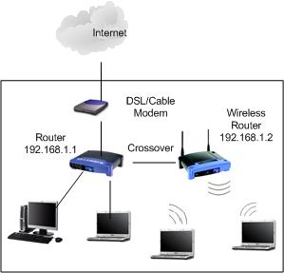






Client
Server
netcat –l –p 8888
netcat <Server’s IP> 8888
[1] http://netcat.sourceforge.net/
Notes:
Necat, A Swiss Army Tool for hacking, which can also be used for many purposes, including
chat server, port scanning, file transfer, getting remote shell (or Netcat's Reverse Shell Functionality), etc
It is available for all platforms, e.g., Windows, Linux.
In Lab 5, we use its chat server function.
To create a simple chat we need two instances of netcat, one to listen for incoming connections (aka the server) and another one to start the connection (aka the client).
For example, run netcat with the '-l' option in order to operate in listening mode on one VM (which is the server). You should also specify the listening port, which is 8888 for the example.
Then, on another VM (which is the client), run another 'netcat' which will initiate the connection by connecting to the server. You should specify the IP address of your VM used for the server, and the TCP port number used by the server.
[click]
However, if we use netcat for chatting or transferring files, all the information transmitted over the Internet is not secure, which could be intercepted by attackers.
[click]
Therefore, we need to protect netcat traffic.

Slide 5
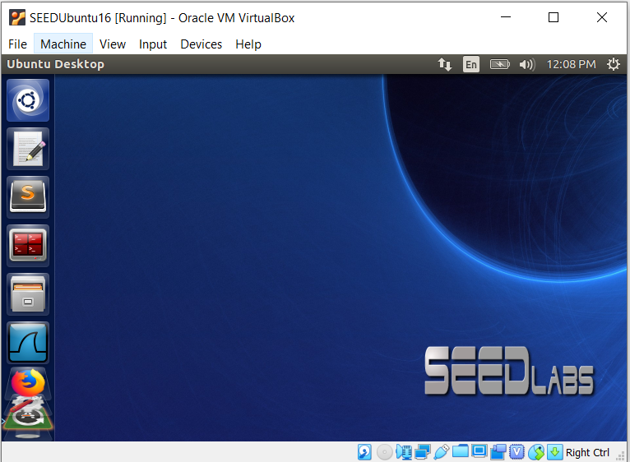
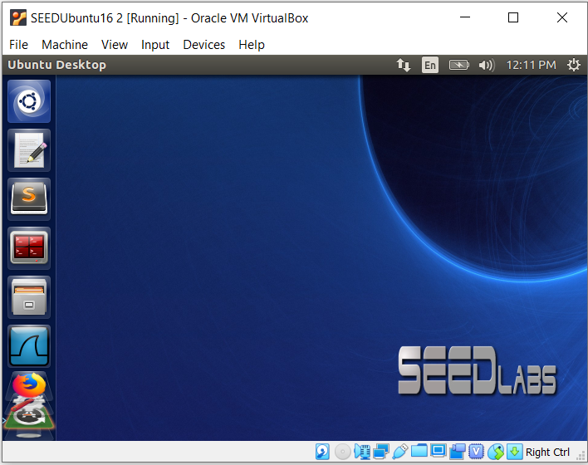

Host A
Host B
Listen on port 8181
Netcat as a client
Netcat as a TCP server
Listen on port 7070
Listen on port 7777
Stunnel
Stunnel
Real TCP networking connection
Virtual TCP networking connection
6
Notes:
Of course, we can re-develop netcat by adding secure communication, which is when two entities are communicating and do not want a third party to listen in.
Specifically, we need to use encryption to protect and securely transmit information online.
However, we are not looking at this option for today’s lab.
Instead, we don’t want to modify the code of netcat, and we will use a standard security protocol, SSL, to protect netcat traffic.
Particularly, we will use Stunnel, an open source program that allows you to encrypt arbitrary TCP connections inside SSL (Secure Sockets Layer).
[click]
As such, we first use Stunnel to create a secure channel protected by SSL.
[click]
Then, all the netcat traffic will pass through the above secure channel established between two VMs.

Slide 6

SSL sits between application protocols and TCP/IP
SSL (Secure Socket Layer)
Application
Application
SSL
SSL
TCP
TCP
IP
IP
Notes:
SSL is a standard security technology for establishing an encrypted link between a server and a client—typically a web server (website) and a browser, or a mail server and a mail client (e.g., Outlook).
SSL sits between application protocols and TCP/IP.
As such, SSL can be used to protect any application protocol.

Slide 7
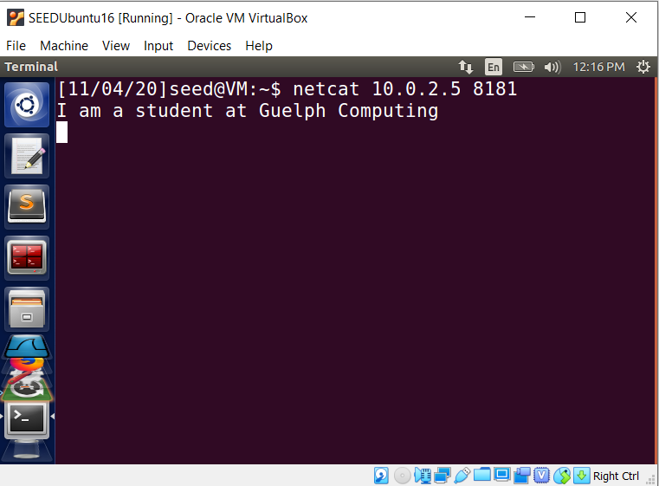
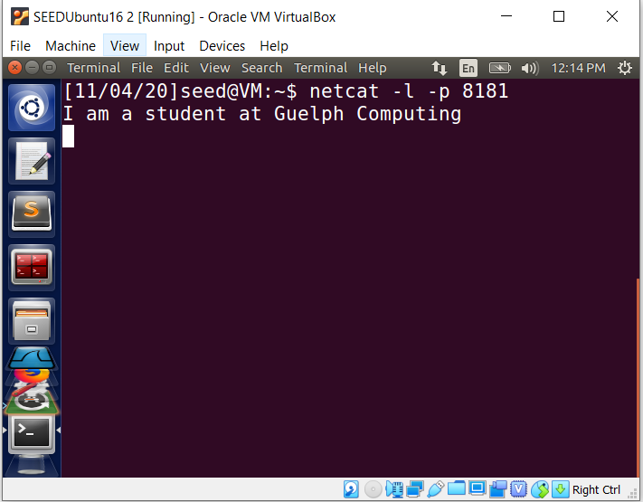
Host A
Host B
Listen on port 8181
Netcat as a client
Netcat as a TCP server
IP: 10.0.2.5
Real TCP networking connection
Notes:
Let us take a look at the regular chat using netcat again. Since all the information exchanged between two VMs is not protected, it is not secure.

Slide 8
Client
Server
netcat –l –p 8181
netcat <Server’s IP> 8181
[1] http://netcat.sourceforge.net/
Notes:
So we will have to protect all the information exchanged between the client and the server.

Slide 9
Host A
Host B
Listen on port 8181
Netcat as a client
Netcat as a TCP server
Listen on port 7070
Listen on port 7777
Stunnel
Stunnel
Real TCP networking connection
Virtual TCP networking connection
Notes:
As mentioned in previous slide, we will use Stunnel, an open source program that allows you to encrypt arbitrary TCP connections inside SSL (Secure Sockets Layer), to first create a secure channel protected by SSL.
[click]
Then, all the netcat traffic will be passed between two VMs through the above established secure channel.

Slide 10
Secure communication with PKI using Stunnel
In this lab exercise, you are required to first establish a secure TCP communication channel between two computers by using Stunnel.
The stunnel utility is a client-side and server-side proxy, which as a server-side proxy, enables SSL connectivity on new port to a non-SSL server.
Host A
Host B
Listen on port 8181
Netcat as a client
Netcat as a server
Listen on port 7070
Listen on port 7777
Client=yes
Stunnel
Cleint=no
Stunnel
client-side proxy
server-side proxy
[1] Stunnel -- Universal SSL Wrapper. http://www.stunnel.org/
Notes:
In this lab, you will use public key cryptography or Public Key Infrastructure (PKI) to achieve secure communication.
Specifically, you are required to first establish a secure TCP communication channel between two VMs by using Stunnel.
The stunnel utility is a client-side and server-side proxy. In computer networking, a proxy
acts as a middleman in the flow of your network traffic between you and a remote server.
As a client-side proxy, it takes a regular TCP client (or non-SSL client) and pass all the information from the client through the secure channel established between stunnel client-side proxy and server-side proxy.
As a server-side proxy, it enables SSL connectivity on new port to a regular TCP server (or non-SSL server).
Please note that you will need to configure stunnel by having client mode as “Yes” on your client VM, which means it is a client-side proxy. Whereas, configuring stunnel by having client mode as “no” on your server VM, which means that it is a server-side proxy.
As such, as a client-side proxy it adds SSL capabilities to a non-SSL client application, for example, netcat client. In the example here, we can let a non-SSL Netcat client talk to a stunnel client-side proxy on port 7070,
As a server-side proxy it adds SSL capabilities to a non-SSL server application, netcat server. In the example here, we can let server-side proxy act on behalf of the netcat server. The server-side proxy will forward the incoming traffic to the real netcat server, which is listening on tcp port 8181.
Please note that, our objective is to let the netcat client and netcat server talk to each other. But, they don’t connect to each other directly. Instead, they talk to each other through their middlemen (proxies).

Slide 11



Secure communication with PKI (cont’d)
1. The client first requests that the server identifies itself;
2. The server sends the client a copy of its public key certificate;
3. The client then checks whether it trusts the certificate received. If so, the client then uses the server's public key to encrypt a randomly chosen symmetric encryption key and sends it to the server;
4. The server is able to decrypt the symmetric encryption key using its private key.
Afterwards, a secure communication channel between the client and the server is established.
Notes:
Next, let us take a look at how secure communication using public key infrastructure (PKI) works.
1. The client first requests that the server identifies itself;
2. The server sends the client a copy of its public key certificate;
3. The client then checks whether it trusts the certificate received. If so, the client then uses the server's public key found within the certificate to encrypt a randomly chosen symmetric encryption key and sends the encrypted symmetric encryption key to the server;
4. The server is able to decrypt the symmetric encryption key using its private key.
Afterwards, a secure communication channel between the client and the server is established by using the shared symmetric encryption key.

Slide 12
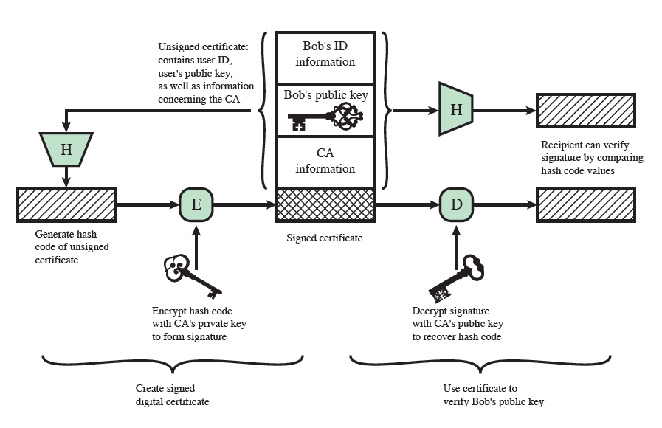
Public-Key Certificate
CA is trusted by the public
Notes:
Let’s recap an important concept in cryptography, which is public-key certificate.
In cryptography, a public key certificate, also known as a digital certificate or identity certificate, is an electronic document used to prove the ownership of a public key.
The certificate includes information about the public key, information about the identity of its owner (called the subject), and the digital signature of a publicly trusted third party on these information. trusted third party is called the issuer, and the certificate issuer is a certificate authority (CA).

Slide 13
Secure communication with PKI (cont’d)
Generate private key and certificate for stunnel server-side proxy using OpenSSL
openssl req -newkey rsa:2048 -nodes -keyout stunnel.pem -x509 -days 365 -out stunnel.pem
Basically, the command above is for creating a private key, creating a certificate using that key (self-signed certificate), and then put them into one file named “stunnel.pem” to use with Stunnel.
[1] OpenSSL Examples. http://cs.uccs.edu/~cs691/crypto/openssl/example.htm
[2] How to create a self-signed SSL Certificate
https://www.akadia.com/services/ssh_test_certificate.html
[3] The Dangers of Self-Signed SSL Certificates
https://www.globalsign.com/en/ssl-information-center/dangers-self-signed-certificates
Notes:
So in order to use stunnel (or SSL) to protect our communication. We will need to generate private key and certificate for stunnel server-side proxy.
Now, we introduce another popular security tool, OpenSSL. OpenSSL is a full-featured toolkit for the Secure Sockets Layer (SSL) and Transport Layer Security (TLS) protocols.
This is an example of using OpenSSL to generate a private key and its corresponding certificate. Basically, the command here is to create an RSA 2048-bit private key, as well as a self-signed certificate, and then put into one file named “stunnel.pem” to use with Stunnel.
Please note that it costs money to get an SSL Certificate from a Commercial Certificate Authority. In our class, it is for educational purpose, we will only use self-signed certificate. In cryptography and computer security, a self-signed certificate is a security certificate that is not signed by a certificate authority (CA), but signed by the user’s own private key. These certificates are easy to make and do not cost money, which is which can be used best for testing purposes or internal usage. However, they do not provide all of the security properties that certificates signed by a CA aim to provide.

Slide 14
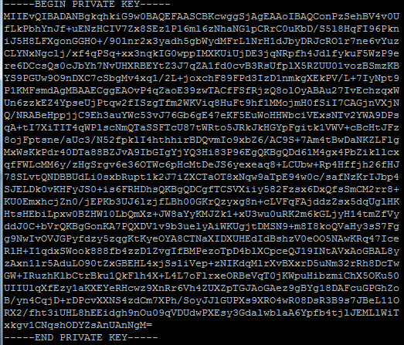

Secure communication with PKI (cont’d)
Notes:
This is an example of a private key.

Slide 15
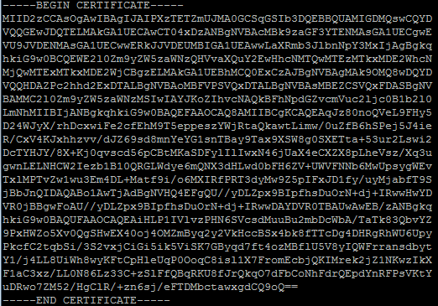

Secure communication with PKI (cont’d)
Notes:
This is an example of a public key certificate.

Slide 16
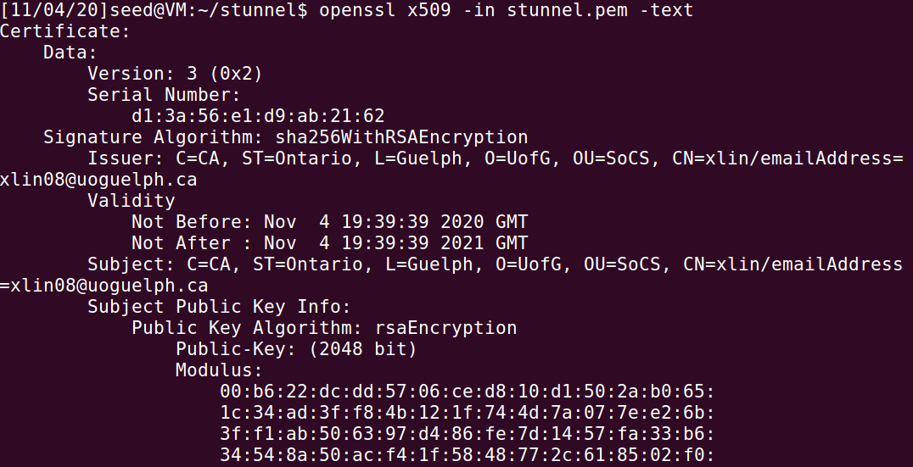
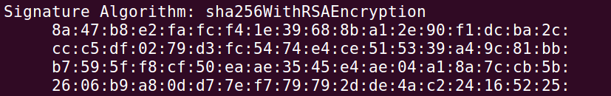
Secure communication with PKI (cont’d)
……
……
Notes:
What is included in a public key certificate?
You can display the contents of a certificate using openssl. The example here shows that it contains some important information, such as an ID, which is the subject, a public key (an RSA 2048-bit public key), and a signature by a CA.

Slide 17

Host A
Host B
Listen on port 8181
Netcat as a client
Netcat as a server
Listen on port 7070
Listen on port 7777
Client=yes
Stunnel
Cleint=no
Stunnel
client-side proxy
server-side proxy
Notes:
So your mission is as follows:
You are required to first establish a secure TCP communication channel between two VMs protected by SSL using Stunnel. The client-side proxy listens on tcp port 7070, and the server-side proxy listens on tcp port 7777. The netcat server is listening on tcp port 8181.
In the end, you can create a chat using netcat, but all the messages exchanged are protected by SSL.

Slide 18

Configure Stunnel on the server side (Host B)
1. create a "stunnel.conf" file in the “/etc/stunnel” directory:
sudo vi /etc/stunnel/stunnel.conf
An overall “stunnel.conf” file for Stunnel on the server side looks like the following:
#Stunnel server configuration file
# Provide the full path to your certificate-key pair file
key=/home/seed/stunnel.pem
cert=/home/seed/stunnel.pem
# up this number to 7 to get full log details
debug=7
# instruct Stunnel to run in the foreground
foreground = yes
client = no
[stunnel]
accept = 8888
connect = 3128
You need to change the configuration for the environment required in the lab.
Notes:
In order to make it happen, you will need to configure Stunnel properly.
First, you will need to configure Stunnel on the server side or server-side proxy. Now stunnel acts such as a SSL server.
Similar to the CIBC online banking website, it needs a public key certificate as well as the corresponding key. We have already created them early.
You now need to specify them in the configuration file of server-side proxy, telling the proxy where to find a public key certificate and the corresponding key.
In computer networking, a proxy acts as a middleman in the flow of your network traffic between you and a server. Therefore, you need to tell stunnel how to accept connections (for example, a specified host:port) and where to replay the connection (for example, connecting to remote host:port).
This is an example configuration of the server-side proxy. You need to change the configuration for the environment required in the lab and based on your experiment environment.

Slide 19
Configure Stunnel on the server side (Host B)
Enabling Stunnel by modifying the /etc/default/stunnel4 file
Note that SSL tunnels are disabled by default.
To enable Stunnel, modify the /etc/default/stunnel4 file
• Navigate to /etc/default
• Open stunnel4 using vi
sudo vi stunnel4
• Change the following line in the /etc/default/stunnel4 file
# Change to one to enable stunnel automatic startup
ENABLED=0
to
# Change to one to enable stunnel automatic startup
ENABLED=1
Otherwise, you may get this error when you try to start Stunnel
Notes:
Also, you will need to enable Stunnel by modifying the /etc/default/stunnel4 file
Note that SSL tunnels are disabled by default.
Use any text editor that you are familiar with to modify the /etc/default/stunnel4 file. Specifically, change the one line here and change to one from 0 to enable stunnel automatic startup.

Slide 20
Configure Stunnel on the server side (Host B)
3. Starting Stunnel:
To start stunnel, run the following command as root:
To become root user type:
su -
When promoted provide the password “seedubuntu”
# stunnel /etc/stunnel/stunnel.conf
By default, stunnel uses /var/log/secure to log its output.
To terminate stunnel, kill the process by running the following command as root:
# kill `cat /var/run/stunnel4.pid`
If you edit the configuration file while stunnel is running, terminate stunnel and start it again for your changes to take effect
Notes:
Afterwards, you can start Stunnel for configuration to take effect on the server VM, using the command here.

Slide 21
Configure Stunnel on the client side (Host A)
1. create a "stunnel.conf" file in the “/etc/stunnel” directory:
sudo vi /etc/stunnel/stunnel.conf
An overall “stunnel.conf” file for Stunnel on the client side looks like the following:
#Stunnel client configuration file
# up this number to 7 to get full log details
debug=7
# instruct Stunnel to run in the foreground
foreground = yes
# enable client mode
client = yes
[cis4510]
accept =8080
connect=[Server’s IP Address]:8888
You need to change the configuration for the environment required in the lab.
Notes:
Then, you will need to configure Stunnel on the client side or client-side proxy. Now stunnel acts such as a SSL client.
Compared to the server-side proxy, the configuration of the client-side proxy is less complicated.
You need to only tell stunnel how to accept connections (for example, a specified host:port) and where to replay the connection (for example, connecting to remote host:port).
This is an example configuration of the client-side proxy. You need to change the configuration for the environment required in the lab and based on your experiment environment.

Slide 22
Configure Stunnel on the client side (Host A)
Enabling Stunnel by modifying the /etc/default/stunnel4 file
Note that SSL tunnels are disabled by default.
To enable Stunnel, modify the /etc/default/stunnel4 file
• Navigate to /etc/default
• Open stunnel4 using emacs
sudo vi stunnel4
• Change the following line in the /etc/default/stunnel4 file
# Change to one to enable stunnel automatic startup
ENABLED=0
to
# Change to one to enable stunnel automatic startup
ENABLED=1
Otherwise, you may get this error when you try to start Stunnel
Notes:
Similarly, you also need to enable Stunnel on client VM by modifying the /etc/default/stunnel4 file

Slide 23
Configure Stunnel on the client side (Host A)
3. Starting Stunnel:
To start stunnel, run the following command as root:
To become root user type:
su -
When promoted provide the password “seedubuntu”
# stunnel /etc/stunnel/stunnel.conf
By default, stunnel uses /var/log/secure to log its output.
To terminate stunnel, kill the process by running the following command as root:
~]# kill `cat /var/run/stunnel4.pid`
If you edit the configuration file while stunnel is running, terminate stunnel and start it again for your changes to take effect
Notes:
Afterwards, you can start Stunnel for configuration to take effect on the client VM, using the command here.

Slide 24
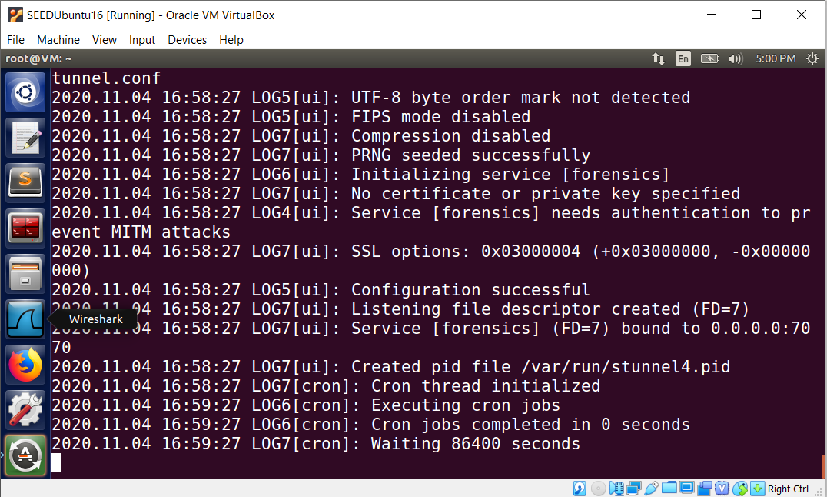
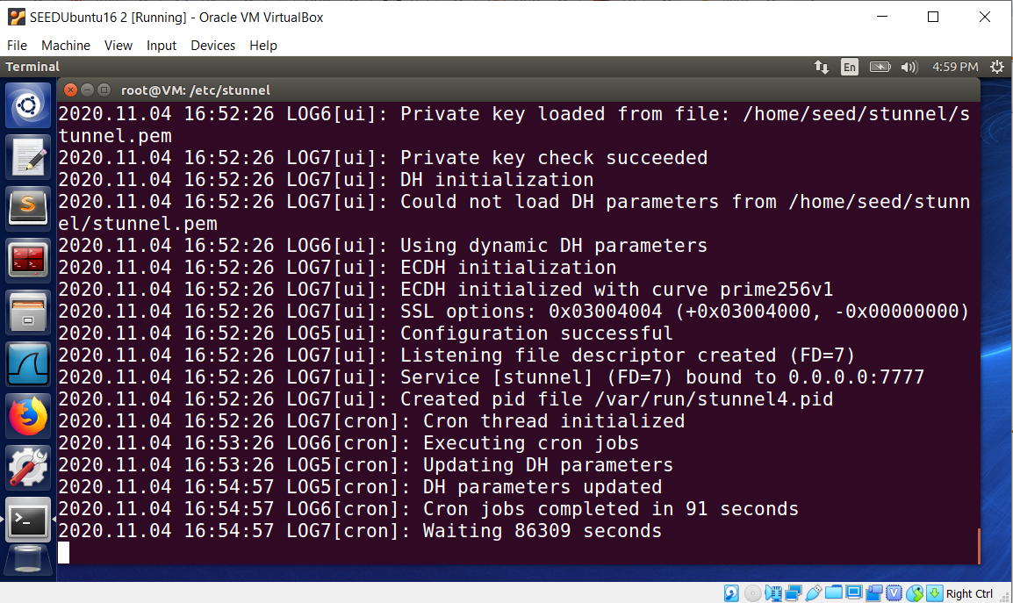
Host A
Host B
Listen on port 8181
Netcat as a client
Netcat as a TCP server
Listen on port 7070
Listen on port 7777
Stunnel
Stunnel
client-side proxy
server-side proxy
Real TCP networking connection
Virtual TCP networking connection
Secure channel
Notes:
Until now, we have established a secure channel protected by SSL using stunnel.
This is an example secure channel establishment.

Slide 25
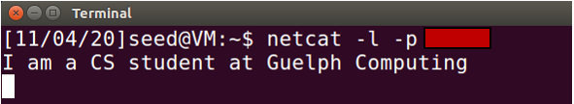

Stunnel on the server side
Host A
Host B
Stunnel on the client side
Netcat starting as a TCP server
Netcat starting as a TCP client
Notes:
Finally, you can use netcat to create a chat using the secure channel, which has been established by using stunnel.
Basically, you can start one more terminal on each VM, and create a chat using netcat.

Slide 26

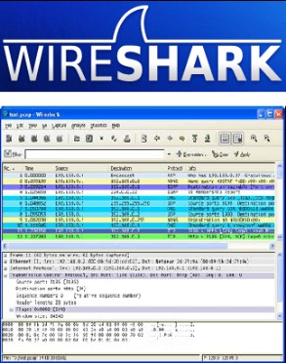
netcat as a server
netcat –l –p 8181
netcat as a client
Stunnel at the client side
Stunnel at the server side
Listen on TCP port 7070
Forward TCP Traffic received (on port 7777) to local TCP port 8181
Notes:
Great! We have turned netcat chat into a secure chat by using stunnel.
You can verify whether the traffic has been encrypted or not using any network sniffing tools, for example, Wireshark or tcpdump.

